Slide 1

CHAT SYSEM
Yao Xiao I Romee Zhou

Slide 2
Motivation
Why Tkinter
Logic & Structures
Aesthetic Choices
GUI Coding Process
Reflection
AGENDA

Slide 3
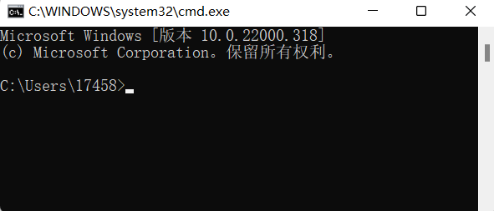

MOTIVATION
Have to finish ICS final project of course : )
Terminal is not convenient and not eye-catching enough
We would like to implement some “painted eggshell” into our final project and maybe designing GUI is the best way

Slide 4

WHY TKINTER
Tkinter vs

Slide 5
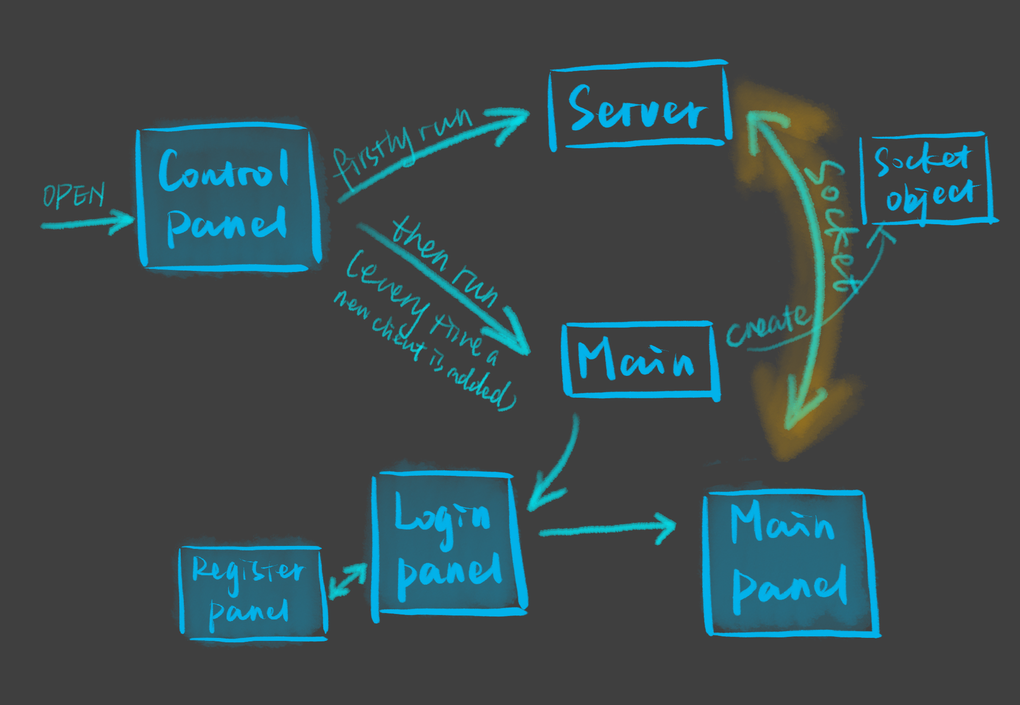
LOGIC & STRUCTURES
By running the control panel, users don’t have to adjust the terminal when running the server or adding new client
Activities here:
Public chat; private chat (support emoji and pictures); checking and searching chat history; playing games
Here, new clients to the system need to sign up first.
Functions include setting username, password and profile image.
Information are stored using database.
Main panel is what a client see after logining into the system.

Slide 6
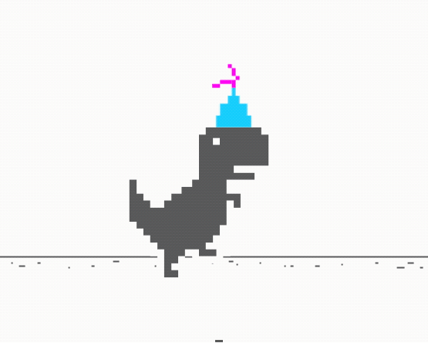

AESTHETIC CHOICES
background="#F0F0F0"
highlightcolor="#F8F8FF"
bg="lightgrey", fg="black"
fg="#00BFFF"
Less is MORE
Referring to CLASSIC
UNIQUENESS

Slide 7

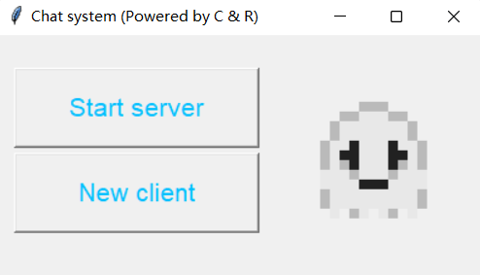
CONTROL PANEL
# Creating GIF image
numIdx = 4
frames = [PhotoImage(file="Control_pad.gif", format="gif -index %i" % (i))
for i in range(numIdx)]
imgLabel = Label(root, height=150, width=150)
imgLabel.place(x=225, y=22)
# Refreshing the frames of the GIF image
def update(idx):
frame = frames[idx]
idx += 1
imgLabel.configure(image=frame)
# Run the function again after 100 ms
root.after(100, update, idx % numIdx)
# Creating “New Client” button
new_client = Button(root, text="New client", fg="#00BFFF",
width=16, height=2, font=("Arial", 16), command=add_new_client)
new_client.place(x=14,y=97)
# Command of “New Client” button
def add_new_client():
# If server has already been started
if server_check == 1:
os.startfile("D:/main.py")
# Give warning otherwise
else:
messagebox.showwarning(
title="Warning",
message="Please start server first!")
def control_panel():
# Creating the main window
root = Tk()
root.configure(background="#F0F0F0")
root.title("Chat system
(Powered by C & R)")
root.geometry("400x200+0+0")
Notes:
START

Slide 8
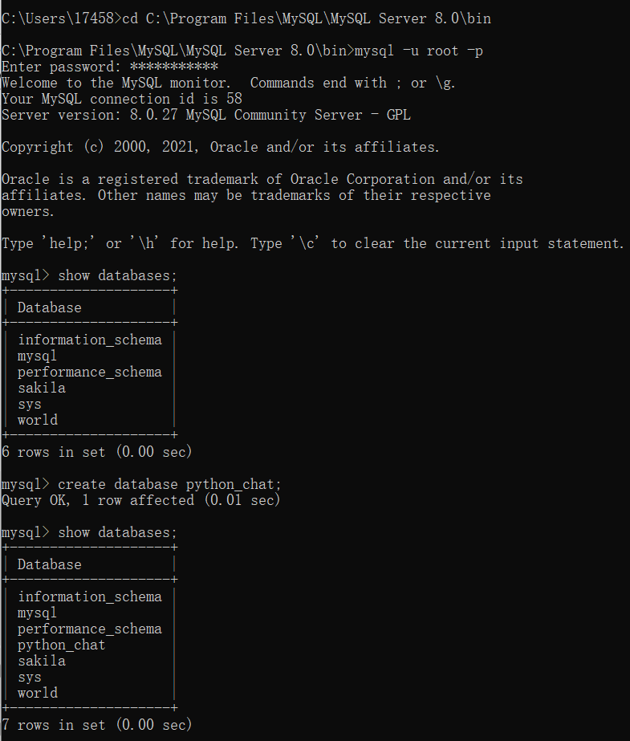
DATABASE
Inserting and searching
in user_information table
Create user_information table in python_chat database
class LogInformation:
# Check if password corresponds username
def login_check(user_name, password):…
# Create new user
def create_new_user(user_name,
password, file_name):…
# Check if username already exists
def select_user_name(user_name):…
# Search for user profile
def fing_face(user_name):…
conn = pymysql.connect(db="python_chat")
cursor = conn.cursor()
sql = """create table user_information
(user_name varchar (20),
password varchar (20),
data BLOB)"""
cursor.execute(sql)
cursor.close()

Slide 9
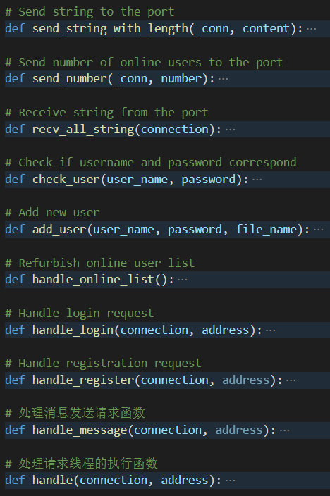
SERVER
def handle(connection, address):
while True:
request_type = str(connection.recv(1024).decode())
no_go = True
# Login request
if request_type == "1":
print("Start processing login request...")
no_go = handle_login(connection, address)
# Registration request
elif request_type == "2":
print("Start processing sign up request...")
no_go = handle_register(connection, address)
# Send message request
elif request_type == "3":
print("Start processing send message request")
no_go = handle_message(connection, address)
# Refurbish online user list request
elif request_type == "4":
print("Start processing refurbish user list request")
no_go = handle_online_list()
if not no_go:
break
if __name__ == "__main__":
try:
# Create socket to accept client connection
server = socket.socket()
CHAT_IP = socket.gethostbyname(socket.gethostname())
CHAT_PORT = 1112
SERVER = (CHAT_IP, CHAT_PORT)
server.bind(SERVER)
server.listen(10)
print("Server running...")
while True:
# Accept client connection, create subthread
connection, address = server.accept()
Thread(target=handle,
args=(connection, address)).start()
except Exception as err:
print("Server error: " + str(err))

Slide 10
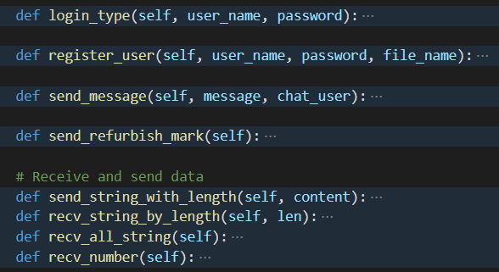
CHAT CLIENT
server.py
# Send request type
send_string_with_length(c, "#!message#!")
# Send chat partner
send_string_with_length(c, "group_chat")
# Send username
send_string_with_length(c, connection_user[connection])
# Send message content
send_string_with_length(c, "* [SYSTEM MESSAGE] " +
connection_user[connection] + "left.")
class ChatSocket:
def __init__(self):
print("Initializing tcp client...")
# Create client socket to connect to the server
self.client_socket = socket.socket()
CHAT_IP = socket.gethostbyname(socket.gethostname())
CHAT_PORT = 1112
SERVER = (CHAT_IP, CHAT_PORT)
self.client_socket.connect(SERVER)
main.py
# Get request type
data_type = client.recv_all_string()
if data_type == "#!message#!":
# Get chat partner, username, and content
chat_flag = client.recv_all_string()
user = client.recv_all_string()
content = client.recv_all_string()
main_frame.show_send_message(
user, content, chat_flag)

Slide 11
MAIN (chat_cmdl_client)
def go_to_login_panel():
global login_frame
global client
client = chat_client.ChatSocket()
login_frame = chat_login_panel.LoginPanel(handding_login,
handding_register, close_login_window)
login_frame.show_login_panel()
login_frame.load()
if __name__ == "__main__":
go_to_login_panel()

Slide 12
MAIN (chat_cmdl_client)
def go_to_login_panel():
global login_frame
global client
client = chat_client.ChatSocket()
login_frame = chat_login_panel.LoginPanel(handding_login,
handding_register, close_login_window)
login_frame.show_login_panel()
login_frame.load()

Slide 13
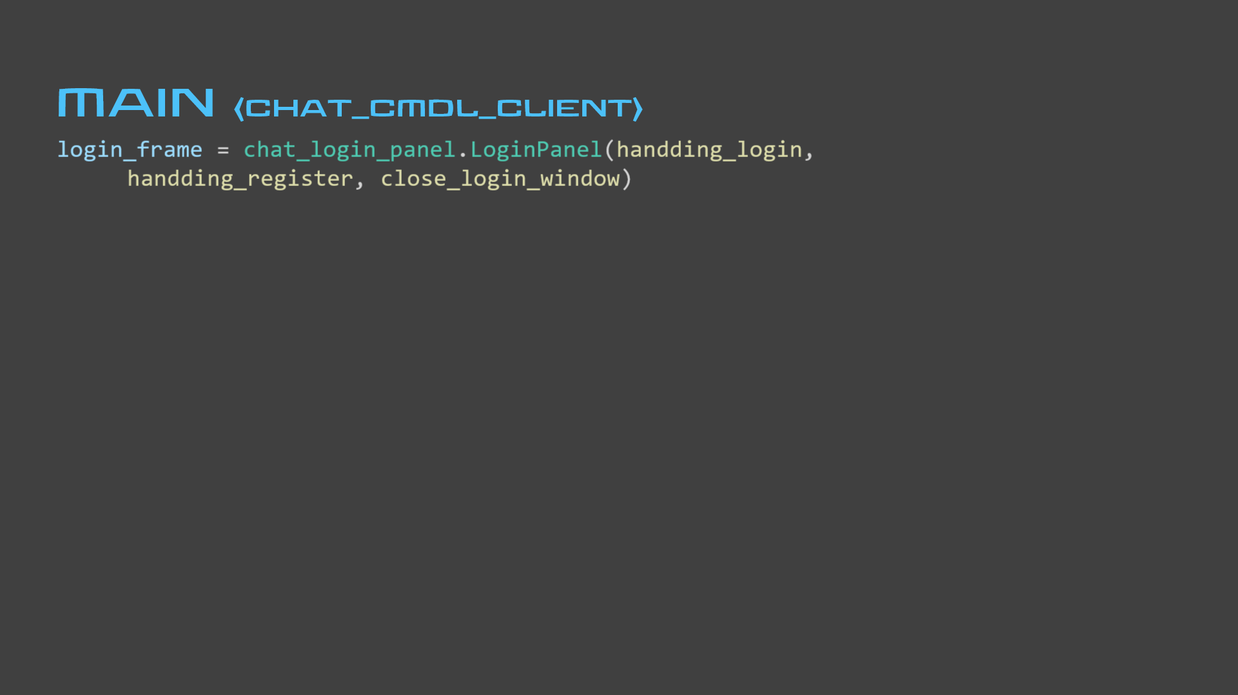
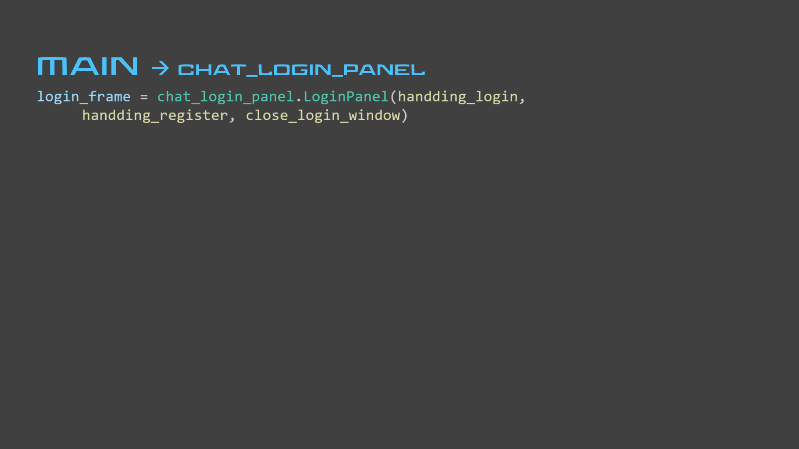
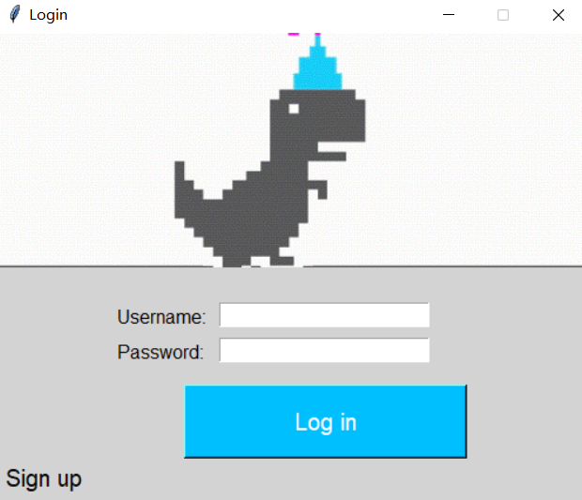
class LoginPanel:
# The arguments are the handling functions
# which are given in main.py, callback with buttons
def __init__(self, handle_login, handle_register, close_login_window):
self.handle_login = handle_login
self.handle_register = handle_register
self.close_login_window = close_login_window
self.entry1 = Entry(login_frame, textvariable=self.user_name,
fg="black", width=25)
self.entry1.place(x=190, y=230)
self.entry2 = Entry(login_frame, textvariable=self.password,
show="*", fg="black", width=25)
self.entry2.place(x=190, y=260)

Slide 14
self.button_register = Button(login_frame, text="Sign up",
relief=FLAT, bg="lightgrey", fg="black", font=("Arial", 15),
command=self.handle_register)
self.button_register.place(x=0, y=360)
self.login_frame.bind("<Return>", self.handle_login)
self.button_login = Button(login_frame, text="Log in",
bg="#00BFFF", fg="white", width=21, height=2, font=("Arial", 15),
command=lambda: self.handle_login(self))
self.button_login.place(x=160, y=300)

Slide 15
def handding_login(self):
user_name, password = login_frame.get_input()
if user_name == "":
messagebox.showwarning(title="Warning", message="Username cannot be empty!")
return
if password == "":
messagebox.showwarning(title="Warning", message="Password cannot be empty!")
return
# If login succeed, go to main panel
if client.login_type(user_name, password) == "1":
go_to_main_panel(user_name)
else:
messagebox.showwarning(title="Warning", message="Wrong username or password!")
def handding_register():
login_frame.close_login_panel() global register_frame # After closing login panel, move to register panel
register_frame = chat_register_panel.RegisterPanel(file_open_face,
close_register_window, register_submit)
# Display register panel
register_frame.show_register_panel()
register_frame.load()

Slide 16
MAIN → chat_register_panel
def handding_register():
login_frame.close_login_panel() global register_frame # After closing login panel, move to register panel
register_frame = chat_register_panel.RegisterPanel(file_open_face,
close_register_window, register_submit)
# Display register panel
register_frame.show_register_panel()
register_frame.load()
def handding_register():
login_frame.close_login_panel() global register_frame # After closing login panel, move to register panel
register_frame = chat_register_panel.RegisterPanel(file_open_face,
close_register_window, register_submit)
# Display register panel
register_frame.show_register_panel()
register_frame.load()
class RegisterPanel:
# The arguments are the handling functions
# which are given in main.py, callback with buttons
def __init__(self, file_open_face, close_register_window, register_submit):
self.file_open_face = file_open_face
self.close_register_window = close_register_window
self.register_submit = register_submit
# User profile directory, initialized as empty
self.file_name = ""

Slide 17
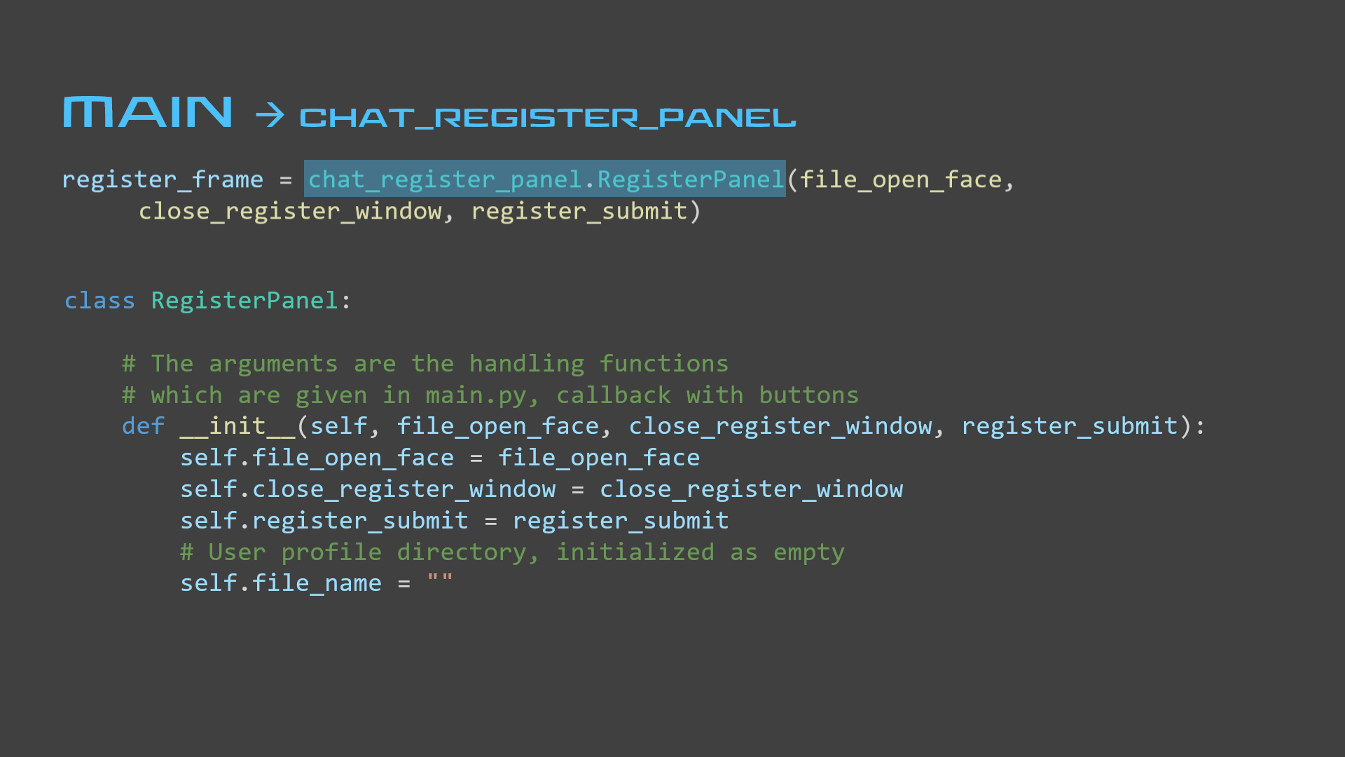
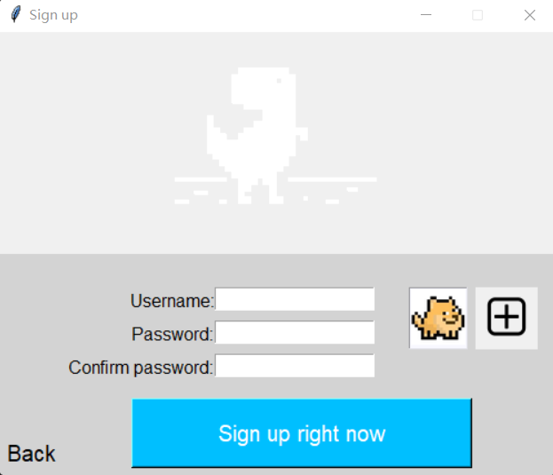
self.button_quit = Button(self.register_frame, text="Back",
relief=FLAT, bg="lightgrey", fg="black", font=("Arial", 15), command=self.close_register_window)
self.button_quit.place(x=0, y=360)
self.register_frame.bind("<Return>", self.register_submit)
self.button_register = Button(self.register_frame,
text="Sign up right now", bg="#00BFFF", fg="white",
width=27, height=2, font=("Arial", 15),
command=lambda: self.register_submit(self))
self.button_register.place(x=120, y=330)
self.button_file_open = Button(self.register_frame, image=self.pp1, relief=FLAT, bd=2, command=self.file_open_face)
self.button_file_open.place(x=430, y=230)

Slide 18
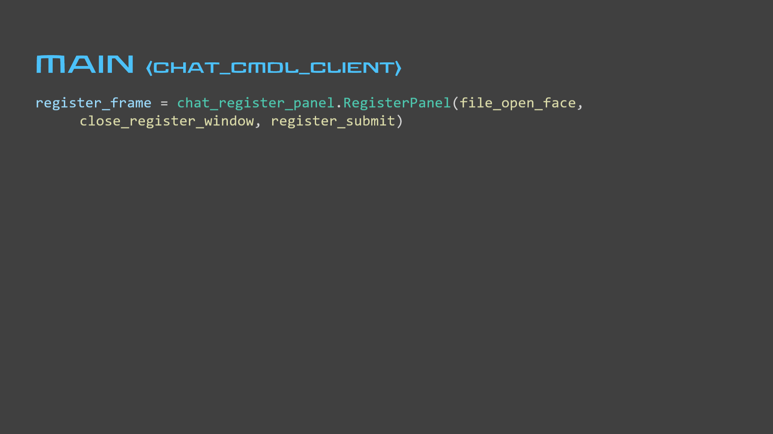
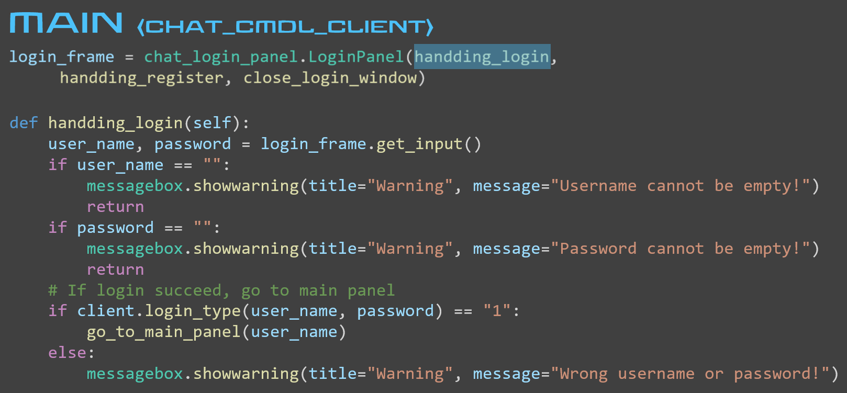
def register_submit(self):
result = client.register_user(user_name, password, file_name)
# If sign up succeed, go no main panel
if result == "0":
messagebox.showinfo("Succeed", "Sign up succeed!")
close_register_window()
# If username already exists, give warning
elif result == "1":
messagebox.showerror("Error", "Username has already been used!")
def close_register_window():
global login_frame
login_frame =
chat_login_panel.LoginPanel(
handding_login,
handding_register,
close_login_window)
login_frame.show_login_panel()
login_frame.load()
def file_open_face():
file_name = tkinter.filedialog.askopenfilename()
# If directory is not empty
if file_name != "":
register_frame.add_face(file_name)
# Otherwise give warning
else:
messagebox.showwarning(title="Warning",
message="You haven't selected a file!")
def register_submit(self):
user_name, password, confirm_password, file_name = register_frame.get_input()
if user_name == "" or password == "" or confirm_password == "":
messagebox.showwarning("Cannot be empty", "Please complete form!")
return
if not password == confirm_password:
messagebox.showwarning("Error", "Two passwords are different!")
return
if register_frame.file_name == "":
messagebox.showwarning("Error", "Please select a profile!")
return
def add_face(self, file_name):
self.file_name = file_name
img = Image.open(file_name)
out = img.resize((self.width, self.height),
Image.ANTIALIAS)
out.save(r"profile.png", "png")
self.p = PhotoImage(file="profile.png")
self.face_show.config(state=NORMAL)
self.face_show.delete("0.0", END)
self.face_show.image_create(END, image=self.p)
self.face_show.config(state=DISABLED)
self.face_show.see(END)

Slide 19
MAIN (chat_cmdl_client)
def go_to_main_panel(user_name):
login_frame.close_login_panel()
global main_frame
main_frame = chat_main_panel.MainPanel(user_name, send_message,
send_mark, send_picture, refurbish_user, private_talk, close_main_window)
# Create subthread for receiving and processing data
threading.Thread(target=recv_data).start()
main_frame.show_main_panel()
main_frame.load()

Slide 20
MAIN (chat_cmdl_client)
def go_to_main_panel(user_name):
login_frame.close_login_panel()
global main_frame
main_frame = chat_main_panel.MainPanel(user_name, send_message,
send_mark, send_picture, refurbish_user, private_talk, close_main_window)
# Create subthread for receiving and processing data
threading.Thread(target=recv_data).start()
main_frame.show_main_panel()
main_frame.load()

Slide 21
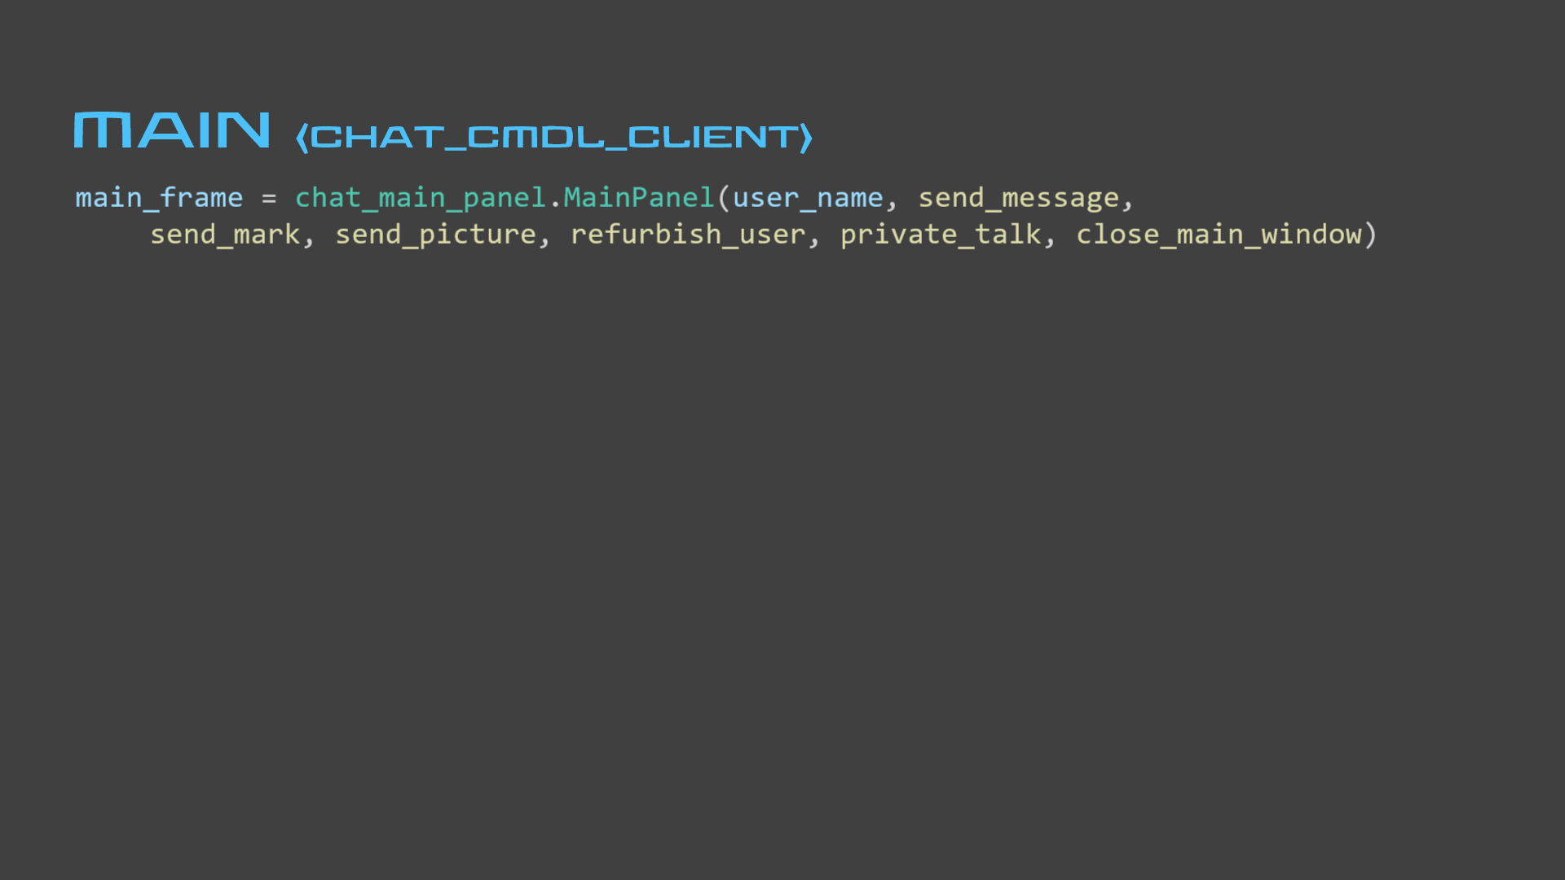
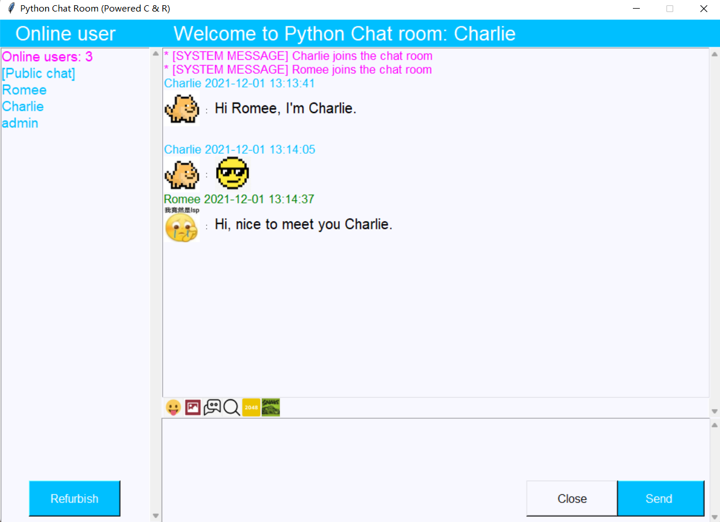
→ chat_main_panel
class MainPanel:
def __init__(self, user_name, send_message, send_mark, send_picture,
refurbish_user, private_talk, close_main_window):
self.user_name = user_name
self.send_message = send_message
self.send_mark = send_mark
self.send_picture = send_picture
self.refurbish_user = refurbish_user
self.private_talk = private_talk
self.close_main_window = close_main_window
self.dic = {} # Emoji dictionary
self.ee = 0 # Judge whether Emoji tab is on
self.pic = {} # Picture dictionary
self.face = [] # User profile list
self.indexer = {} # Chat history indexer
Online user list
Send text
Send emoji
Send picture
All chat history
Search chat history
Show message
2048 game (single player)
Snake game (single player)

Slide 22
CHAT_MAIN_PANEL → online user list
CHAT_MAIN_PANEL
def refresh_friends(self, online_number, names):
# Clear current online user list
self.friend_list.delete(0, END)
# Plug in current online users
for name in names:
self.friend_list.insert(0, name)
# Plug in [Public chat] tab
self.friend_list.insert(0, "[Public chat]")
self.friend_list.itemconfig(0, fg="#00BFFF")
# Plug in online user numbers
self.friend_list.insert(0, "Online users: "
+ str(online_number))
self.friend_list.itemconfig(0, fg="#FF00FF")
main.py
chat_main_panel.py
Thread(target=recv_data).start()
def show_main_panel(self):
def refurbish_user():
client.send_refurbish_mark()
if data_type == "#!onlinelist#!":
online_list = list()
online_number = client.recv_number()
for n in range(online_number):
# Get username from the server
online_list.append(
client.recv_all_string())
main_frame.refresh_friends(
online_number, online_list)
button5 = Button(self.main_frame,
command=self.refurbish_user,
text="Refurbish",
bg="#00BFFF", fg="white",
width=13, height=2,
font=("Arial", 12))
button5.place(x=40, y=640)
chat_client.py
def send_refurbish_mark(self):
self.client_socket.sendall(
bytes("4", "utf-8"))

Slide 23
CHAT_MAIN_PANEL → send text
CHAT_MAIN_PANEL
main.py
def send_message(self, message, chat_user):
self.client_socket.sendall(bytes("3", "utf-8"))
self.send_string_with_length(chat_user)
self.send_string_with_length(message)
self.main_frame.bind("<Return>", self.send_message)
button1 = Button(self.main_frame,
command=lambda: self.send_message(self),
text="Send", bg="#00BFFF", fg="white",
width=13, height=2, font=("Arial", 12))
button1.place(x=850, y=640)
def send_message(self):
global chat_user
content = main_frame.get_send_text()
main_frame.clear_send_text()
if content.strip() == "":
messagebox.showwarning(title="Warning",
message="Cannot send empty message!")
return
client.send_message(content, chat_user)
chat_client.py
chat_user = "[Public chat]"

Slide 24
CHAT_MAIN_PANEL → send text
main.py
def private_talk(self): global chat_user
indices = main_frame.friend_list.curselection()
index = indices[0]
if index > 0:
chat_user = main_frame.friend_list.get(index)
if chat_user == "[Public chat]":
title = "Welcome to Public chat room: " + main_frame.user_name)
main_frame.change_title(title) elif chat_user == main_frame.user_name:
messagebox.showwarning(title="Warning",
message="You cannot chat with yourself!")
chat_user = "[Public chat]"
else:
title = "[Private chat]" + chat_user)
main_frame.change_title(title)
self.friend_list = Listbox(self.main_frame, selectmode=NO,
listvariable=friend_list_var, bg="#F8F8FF", fg="#00BFFF",
font=("Arial", 14), highlightcolor="#F8F8FF",
selectbackground="#00BFFF")
self.friend_list.grid(row=1, column=0, rowspan=3, sticky=N+S,
padx=0, pady=(0, 0))
# Bind clicking to method private_talk
self.friend_list.bind("<ButtonRelease-1>", self.private_talk)

Slide 25
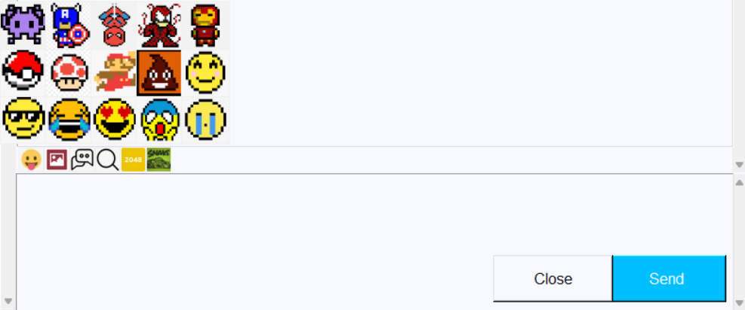
CHAT_MAIN_PANEL → send emoji
CHAT_MAIN_PANEL
CHAT_MAIN_PANEL → send text
def express(self):
if self.ee == 0:
self.ee = 1
# Place all emoji buttons
self.b1 = Button(self.main_frame,
command=self.bb1,
image=self.p1,
relief=FLAT, bd=0)
self.b1.place(x=207, y=470)
# etc.
else:
self.ee = 0
# Destroy all emoji buttons
self.b1.destroy()
# etc.
button3 = Button(self.main_frame,
command=self.express,
relief=FLAT, bd=0)
button3.place(x=227, y=525)
# Change emojis into
# PhotoImage class objects
self.p1 = PhotoImage(file="E1.png")
# etc.
# Map each emoji to an emoji mark
self.dic = {"aa**": self.p1, # etc.}
def bb1(self):
self.mark("aa**")
# etc.
def mark(self, exp):
self.send_mark(exp)
# Destroy all emoji buttons
self.b1.destroy()
# etc.
self.ee = 0
def send_mark(exp): global chat_user
client.send_message(exp, chat_user)

Slide 26
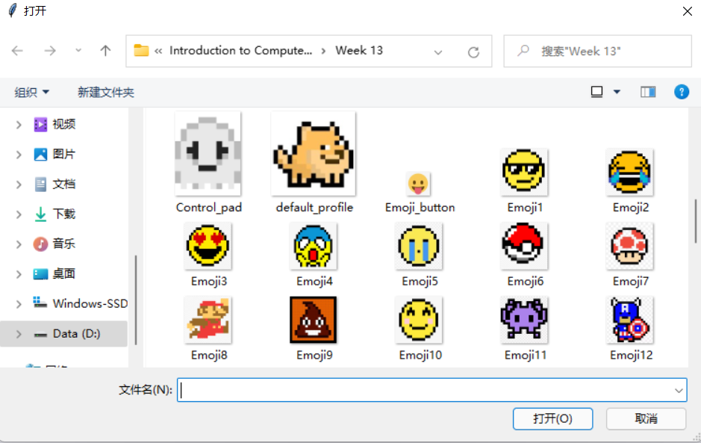
CHAT_MAIN_PANEL → send picture
CHAT_MAIN_PANEL
CHAT_MAIN_PANEL → send emoji
def picture(self):
pic_file = tkinter.filedialog.askopenfilename()
img = Image.open(pic_file)
# Adjust size of the picture
width, height = img.size
if width > 500:
width, height = 500, int(height / width * 500)
out = img.resize((width, height),Image.ANTIALIAS)
out.save(pic_file[:-4] + "_save.png", "png")
self.send_picture("pic**" + pic_file)
button8 = Button(self.main_frame, command=self.picture,
relief=FLAT, bd=0)
button8.place(x=254, y=525)

Slide 27
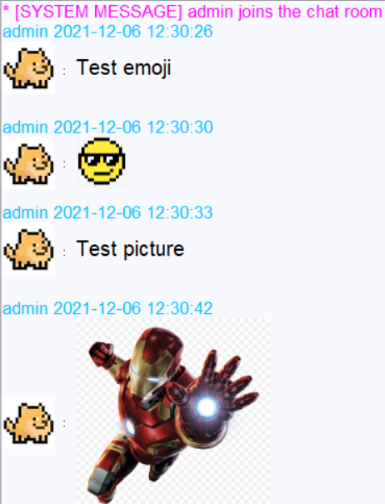
CHAT_MAIN_PANEL → show message
CHAT_MAIN_PANEL
server.py
main.py
Thread(target=recv_data).start()
Thread(target=handle, args=(connection, address)).start()
request_type == "3": handle_message(connection, address)
elif data_type == "#!message#!":
print("Accessing new message")
# Get chat-to-elephantpartner and username
chat_flag = client.recv_all_string()
user = client.recv_all_string()
print("User: " + user)
# Get set content from the server
content = client.recv_all_string()
print("Message: " + content)
main_frame.show_send_message(user, content, chat_flag)
global join_user
global flag
# Login succeed just now, send user joining message to all
if flag == 1:
for c in online_connection:
send_string_with_length(c, "#!message#!")
send_string_with_length(c, "group_chat")
send_string_with_length(c, connection_user[connection])
send_string_with_length(c, "* [SYSTEM MESSAGE] " +
connection_user[connection] + " joins the chat room")
# Not processing login case
else:
chat_user = recv_all_string(connection)
content = recv_all_string(connection)
# User leaves chat room, send user leaving message to all
if content == "exit":
for c in online_connection:
send_string_with_length(c, "#!message#!")
send_string_with_length(c, "group_chat")
send_string_with_length(c, connection_user[connection])
send_string_with_length(c, "* [SYSTEM MESSAGE] " +
connection_user[connection] + " has left the chat room")
# Not login or exit cases, send message
else:
# If chatting in private room
else:
for c in online_connection:
if connection_user[c] == chat_user:
send_string_with_length(c, "#!message#!")
send_string_with_length(c, "private_chat")
send_string_with_length(c, connection_user[connection])
send_string_with_length(c, content)
send_string_with_length(connection, "#!message#!")
send_string_with_length(connection, "private_chat")
send_string_with_length(connection,
connection_user[connection])
send_string_with_length(connection, content)
# Not login or exit cases, send message
else:
# If chatting in public room
if chat_user == "[Public chat]":
for c in online_connection:
send_string_with_length(c, "#!message#!")
send_string_with_length(c, "group_chat")
send_string_with_length(c, connection_user[connection])
send_string_with_length(c, content)

Slide 28
CHAT_MAIN_PANEL → show message
def show_send_message(self, user_name, content, chat_flag):
title = user_name + " " + time.strftime("%Y-%m-%d %H:%M:%S",
time.localtime()) + "\n"
# Message from self, blue in group chat, red in private chat
elif user_name == self.user_name:
if chat_flag == "group_chat":
self.message_text.tag_config("tag_4", foreground="#00BFFF")
self.message_text.insert(END, title, "tag_4")
self.sava_chatting_records(title)
elif chat_flag == "private_chat":
self.message_text.tag_config("tag_5", foreground="#DC143C")
self.message_text.insert(END, title, "tag_5")
self.sava_chatting_records(title)
# Message from others, green in group chat, red in private chat
else:
if chat_flag == "group_chat":
self.message_text.tag_config("tag_6", foreground="#008000")
self.message_text.insert(END, title, "tag_6")
self.sava_chatting_records(title)
elif chat_flag == "private_chat":
self.message_text.tag_config("tag_7", foreground="#DC143C")
self.message_text.insert(END, title, "tag_7")
self.sava_chatting_records(title)
# System message is purple
if content == "* [SYSTEM MESSAGE] " + user_name
+ " joins the chat room":
self.message_text.tag_config("tag_1", foreground="#FF00FF")
self.message_text.insert(END, content + "\n", "tag_1")
elif content == "* [SYSTEM MESSAGE] " + user_name
+ " has left the chat room":
self.message_text.tag_config("tag_2", foreground="#DC143C")
self.message_text.insert(END, content + "\n", "tag_2")

Slide 29
CHAT_MAIN_PANEL → show message
self.dic = {"aa**": self.p1, "bb**": self.p2, "cc**": self.p3,
"dd**": self.p4, "ee**": self.p5, "ff**": self.p6,
"gg**": self.p7, "hh**": self.p8, "jj**": self.p9,
"kk**": self.p10, "ll**": self.p11, "mm**": self.p12,
"nn**": self.p13, "pp**": self.p14, "qq**": self.p15}
# Content is emoji
if content in self.dic:
# Get user profile from database
chat_mysql.LogInformation.fing_face(user_name)
time.sleep(0.5)
self.img1 = Image.open("user_profile.png")
self.out1 = self.img1.resize((50, 50), Image.ANTIALIAS)
self.out1.save(r"user_profile1.png", "png")
time.sleep(0.5)
self.face.append(PhotoImage(file="user_profile1.png"))
self.message_text.image_create(END, image=self.face[-1])
self.message_text.insert(END, " : ")
# Insert the emoji
self.message_text.image_create(END, image=self.dic[content])
self.message_text.insert(END, "\n\n")
self.message_text.see(END)
self.sava_chatting_records("[Emoji]\n\n")

Slide 30
CHAT_MAIN_PANEL → show message
self.send_picture("pic**" + pic_file)
# Content is picture
elif content[:5] == "pic**":
# Get user profile from database
chat_mysql.LogInformation.fing_face(user_name)
time.sleep(0.5)
self.img1 = Image.open("user_profile.png")
self.out1 = self.img1.resize((50, 50), Image.ANTIALIAS)
self.out1.save(r"user_profile3.png", "png")
time.sleep(0.5)
self.face.append(PhotoImage(file="user_profile3.png"))
self.message_text.image_create(END, image=self.face[-1])
self.message_text.insert(END, " : ")
# Transfer the picture into a PhotoImage class object
# Save the PhotoImage class object into dictionary,
# with its key the filename concatenated with a float
prefx = str(random()) + "_"
filename = content[5:-4] + "_save.png"
img = PhotoImage(file=filename)
self.pic[prefx + filename] = img
# Insert the picture
self.message_text.image_create(END,
image=self.pic[prefx + filename])
self.message_text.insert(END, "\n\n")
self.message_text.see(END)
self.sava_chatting_records("[Picture]\n\n")

Slide 31
CHAT_MAIN_PANEL → show message
# Content is text
elif content[:18] != "* [SYSTEM MESSAGE]":
# Get user profile from database
# --------Omit this part--------
# Insert the text
self.message_text.tag_config("tag_8", foreground="#000000",
font=tf.Font(family="Arial", size=15))
self.message_text.insert(END, content, "tag_8")
self.message_text.see(END)
self.sava_chatting_records(content)
self.indexing_chatting_records(title, content)

Slide 32
CHAT_MAIN_PANEL → show message
# Content is text
elif content[:18] != "* [SYSTEM MESSAGE]":
# Get user profile from database
# --------Omit this part--------
# Insert the text
self.message_text.tag_config("tag_8", foreground="#000000",
font=tf.Font(family="Arial", size=15))
self.message_text.insert(END, content, "tag_8")
self.message_text.see(END)
self.sava_chatting_records(content)
self.indexing_chatting_records(title, content)

Slide 33
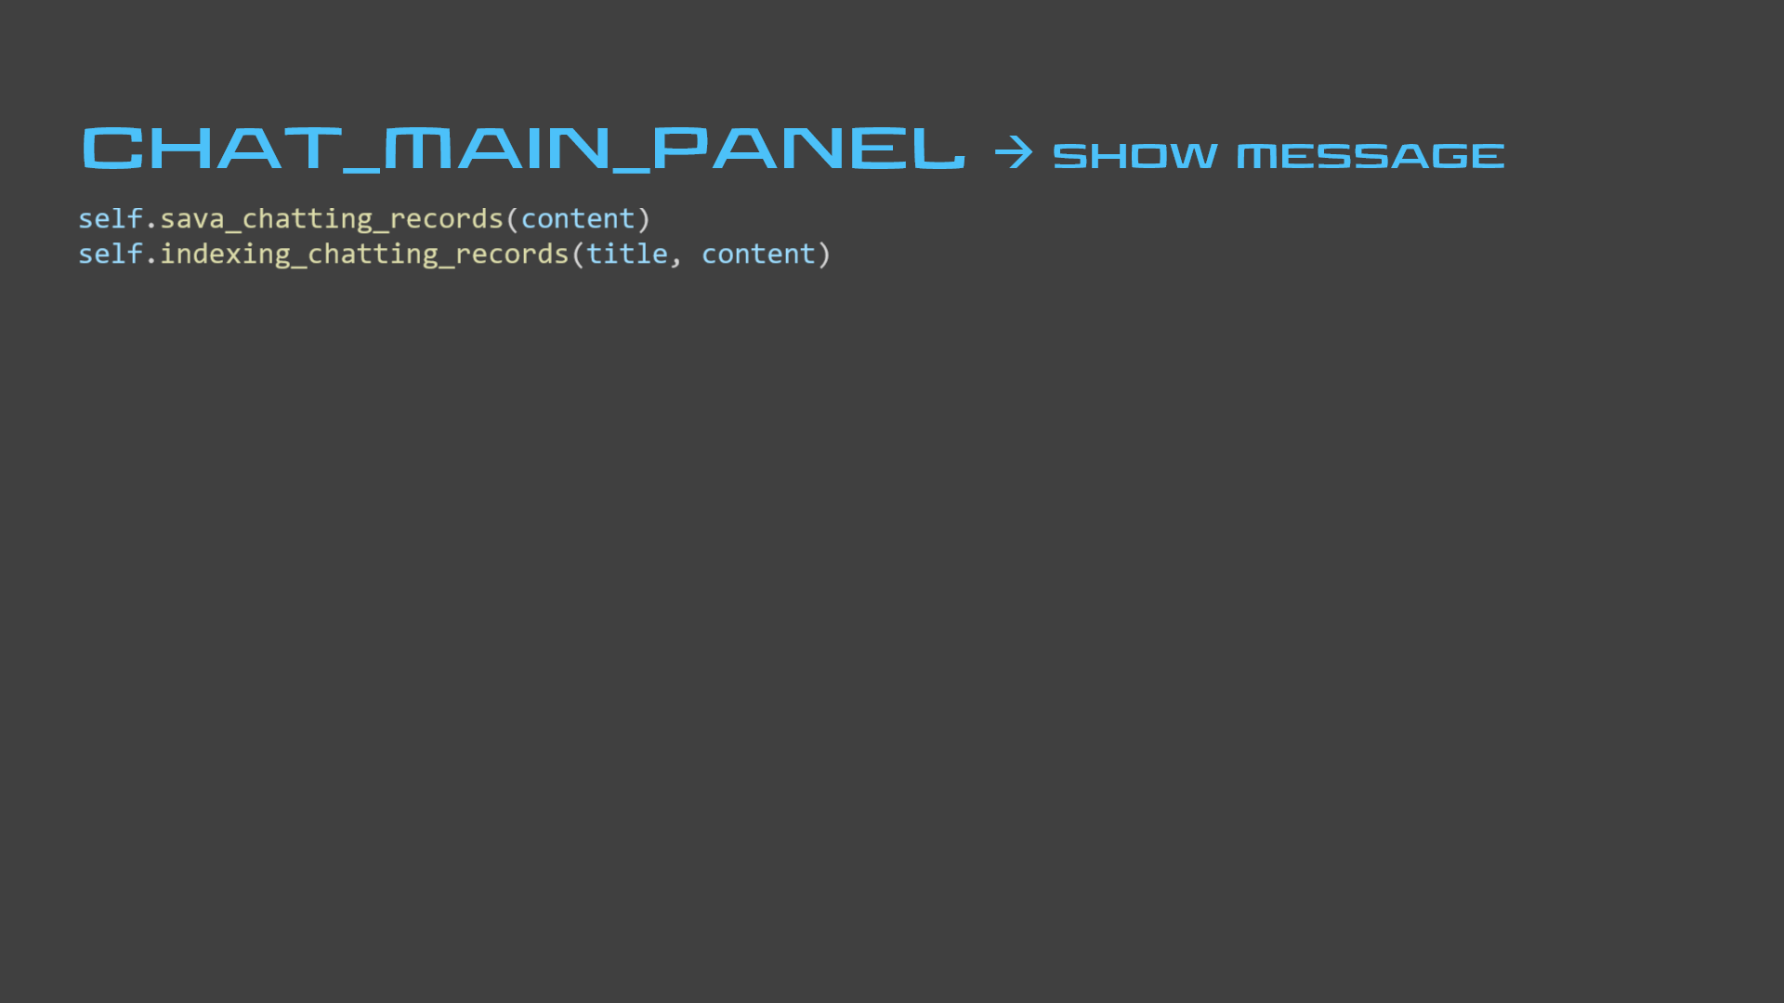
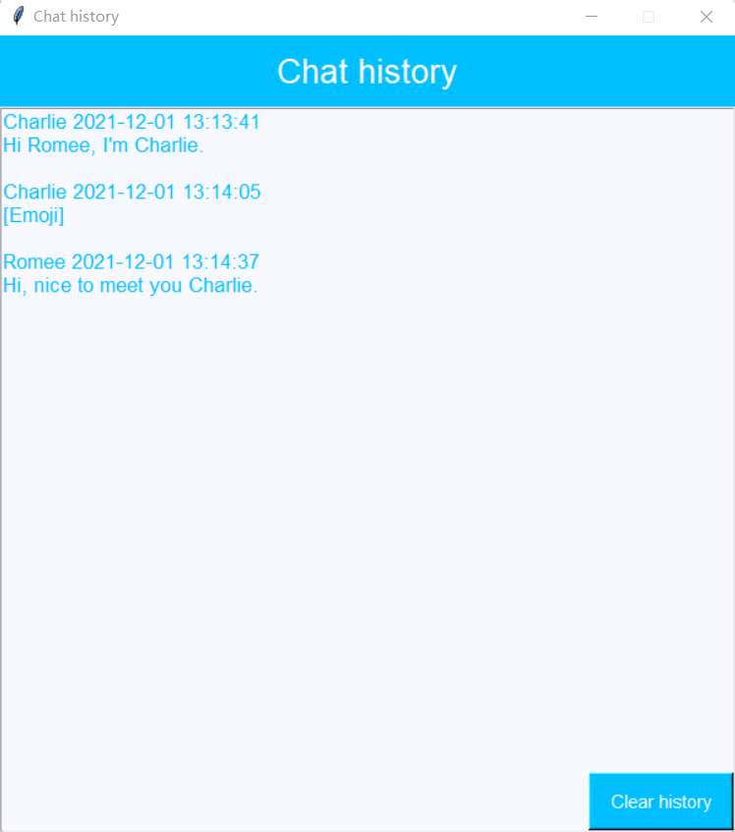
→ all chat history
def show_chatting_records(self):
f = open("D:/ICS_final/chatting_records/"
+ self.user_name + ".txt", "r")
while True:
content = f.readline()
self.chatting_records.tag_config("tag_9",
foreground="#00BFFF",
font=tf.Font(family="Arial", size=13))
if content != "":
self.chatting_records.insert(END,
content, "tag_9")
else:
return
def clear_chatting_records(self):
self.chatting_records.delete("1.0", END)
# Cover the history with empty string
a = open("D:/ICS_final/chatting_records/"
+ self.user_name + ".txt", "w")
a.write("")
a.close()
def create_window(self):
top1 = Toplevel()
top1.configure(background="#FFFAFA")
top1.title("Chat history")
# Create textbox to hold chat history
self.chatting_records = Text(top1,
bg="#F8F8FF", height=50,
highlightcolor="#F8F8FF",
highlightthickness=1)
self.chatting_records.pack(ipady=10, fill=X)
# Create the “clear history” button
button6 = Button(top1, text="Clear history",
command=self.clear_chatting_records,
bg="#00BFFF", fg="white", width=12,
height=2, font=("Arial", 11))
button6.place(x=480, y=600)
self.show_chatting_records()
def sava_chatting_records(self, content):
# Open the .txt file named by username
# Append to the end latest chatting records
a = open("D:/ICS_final/chatting_records/" +
self.user_name + ".txt", "a")
a.write(content)
a.close()

Slide 34
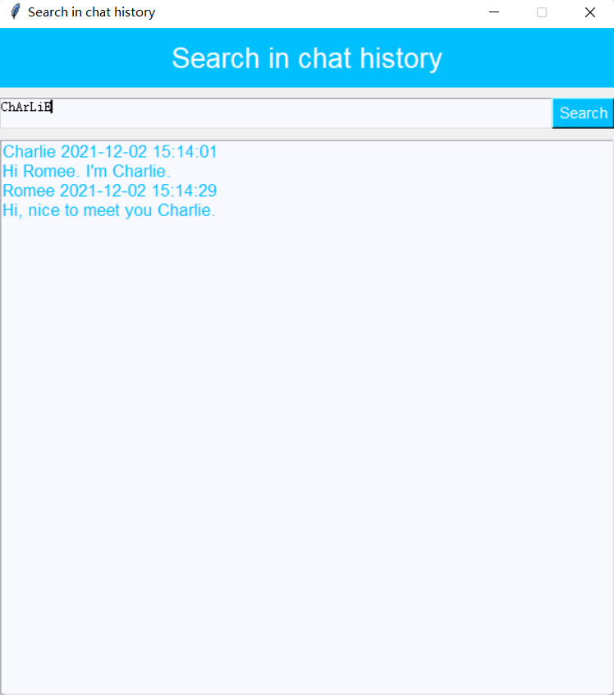
→ all chat history
→ show chat history
def create_search_window(self):
# Create search button
search_message_button = Button(search_frame, command=lambda: self.show_search_results(self.get_search_term()[:-1]))
search_message_button.pack(side=RIGHT)
def show_search_results(self, term):
self.clear_search_result()
self.search_chatting_records.tag_config("tag_10",
foreground="#00BFFF", font=tf.Font(family="Arial", size=13)))
if term.lower() in self.indexer:
# Avoid repetition
results = set()
for result in self.indexer[term.lower()]:
results.add(result)
for result in results:
self.search_chatting_records.insert(
END, result, "tag_10")
def indexing_chatting_records(self, title, text):
splitted_text = text.split()
# Avoid punctuation
words = []
for w in splitted_text:
temp = ""
for ch in w:
if ch.isalpha():
temp += ch.lower()
if temp != "":
words.append(temp)
# Map to a list of texts containing the phrase
for n in range(1, len(words) + 1):
n_grams = ngrams(words, n)
for tup in list(n_grams):
phrase = " ".join(tup)
if phrase not in self.indexer:
self.indexer[phrase] = [title + text,]
else:
self.indexer[phrase].append(title + text)

Slide 35
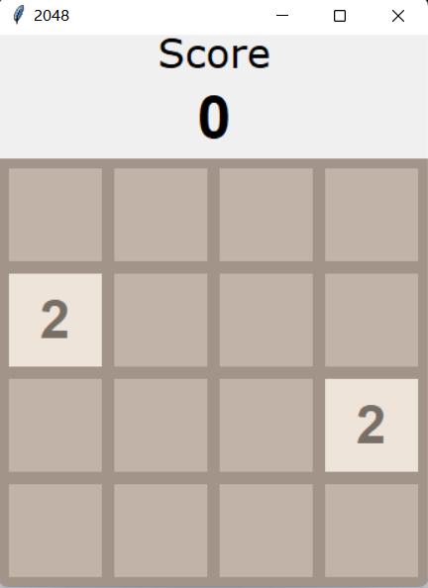
2048 GAME
color_2048.py
GRID_COLOR = "#A39489"
EMPTY_CELL_COLOR = "#C2B3A9"
SCORE_LABEL_FONT = ("Verdana", 24)
SCORE_FONT = ("Helvetica", 36, "bold")
GAME_OVER_FONT = ("Helvetica", 36, "bold")
GAME_OVER_FONT_COLOR = "#F9F6F2"
WINNER_BG = "#EDCF72"
LOSER_BG = "#A39489"
CELL_COLORS = {2: "#EEE4DA", 4: "#EDE0CB", 8: "#F2B179",
16: "#F59563", 32: "#F67C5F", 64: "#F65E3B",
128: "#EDCF72", 256: "#EDCC61", 512: "#EDC850",
1024: "#EDC53F", 2048: "#EDC22E", 4096: "#3C3A32",
8192: "#3C3A32"}
CELL_NUMBER_COLORS = {2: "#776E65", 4: "#776E65", 8: "#F9F6F2",
16: "#F9F6F2", 32: "#F9F6F2", 64: "#F9F6F2",
128: "#F9F6F2", 256: "#F9F6F2", 512: "#F9F6F2",
1024: "#F9F6F2", 2048: "#F9F6F2", 4096: "#F9F6F2",
8192: "#F9F6F2"}
CELL_NUMBER_FONTS = {2: ("Helvetica", 32, "bold"),
4: ("Helvetica", 32, "bold"), 8: ("Helvetica", 32, "bold"),
16: ("Helvetica", 32, "bold"), 32: ("Helvetica", 32, "bold"),
64: ("Helvetica", 32, "bold"), 128: ("Helvetica", 27, "bold"),
256: ("Helvetica", 27, "bold"), 512: ("Helvetica", 27, "bold"),
1024: ("Helvetica", 17, "bold"), 2048: ("Helvetica", 17, "bold"),
4096: ("Helvetica", 17, "bold"), 8192: ("Helvetica", 17, "bold")}
import colors_2048 as c
score_frame = Frame(self)
score_frame.place(relx=0.5, y=45,
anchor="center")
score_title = Label(score_frame,
text="Score",
font=c.SCORE_LABEL_FONT)
score_title.grid(row=0)
# Initialize score as 0
self.score_label = Label(score_frame,
text="0", font=c.SCORE_FONT)
self.score_label.grid(row=1)
→ show chat history
→ 2048 game
def make_GUI(self):
# Create a matrix to
# hold information of each cell
self.cells = []
for i in range(4):
row = []
for j in range(4):
# Create a cell
cell_frame = Frame(self.main_grid, bg=c.EMPTY_CELL_COLOR,
width=75, height=75)
cell_frame.grid(row=i, column=j, padx=5, pady=5)
# Initialize as empty cell
cell_number = Label(self.main_grid, bg=c.EMPTY_CELL_COLOR)
cell_number.grid(row=i, column=j)
# Create dictionary to hold color and number of the cell
cell_data = {"frame": cell_frame, "number": cell_number}
row.append(cell_data)
self.cells.append(row)
button7 = Button(self.main_frame, command=self.game_2048)
button7.place(x=335, y=525)
def game_2048(self):
os.startfile("D:/ICS_final/game_2048.py")

Slide 36
2048 GAME
def update_GUI(self):
for i in range(4):
for j in range(4):
# Get the number of each cell
cell_value = self.matrix[i][j]
# Adjust to corresponding number color and fill color
if cell_value == 0:
self.cells[i][j]["frame"].configure(bg=c.EMPTY_CELL_COLOR)
self.cells[i][j]["number"].configure(bg=c.EMPTY_CELL_COLOR,
text="")
else:
self.cells[i][j]["frame"].configure(bg=c.CELL_COLORS[cell_value])
self.cells[i][j]["number"].configure(bg=c.CELL_COLORS[cell_value],
fg=c.CELL_NUMBER_COLORS[cell_value],
font=c.CELL_NUMBER_FONTS[cell_value],
text=str(cell_value))
# Update the score
self.score_label.configure(text=self.score)
# Force update GUI
self.update_idletasks()
def add_new_tile(self):
if any(0 in row for row in self.matrix):
# Randomly choose an empty cell
row = random.randint(0, 3)
col = random.randint(0, 3)
while self.matrix[row][col] != 0:
row = random.randint(0, 3)
col = random.randint(0, 3)
# Fill with 2 (90%) or 4 (10%)
self.matrix[row][col] = numpy.random.choice([2, 4], p=[0.9, 0.1])

Slide 37
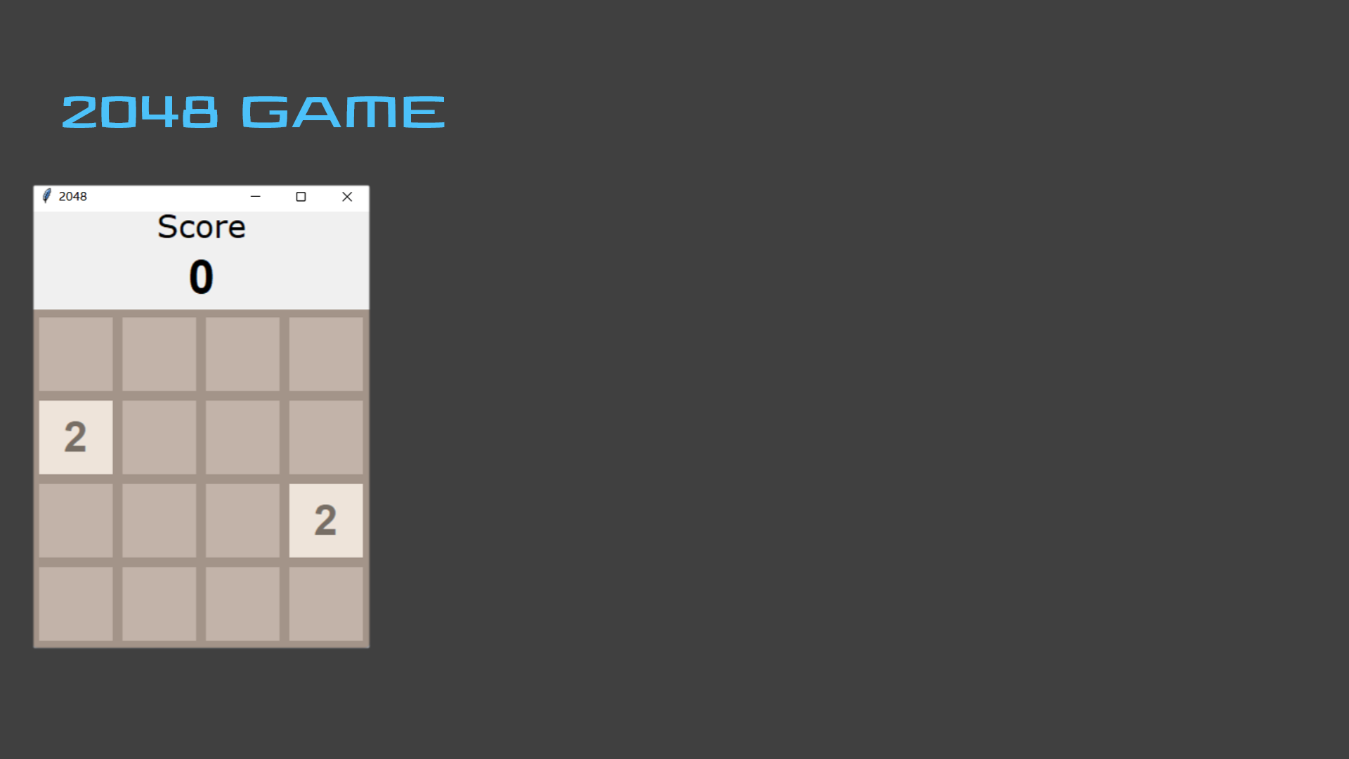
def game_over(self):
if any(2048 in row for row in self.matrix) and not self.keep_playing
and not self.win:
game_over_frame = Frame(self.main_grid, borderwidth=0)
game_over_frame.place(relx=0.5, rely=0.5, anchor="center")
win_label = Label(game_over_frame, text=" You win! ", bg=c.WINNER_BG,
fg=c.GAME_OVER_FONT_COLOR, font=c.GAME_OVER_FONT)
win_label.pack()
if messagebox.askyesno("2048", "Continue the game?"):
self.keep_playing = True
win_label.destroy()
game_over_frame.destroy()
# If choose not to go on, shut down keyboard functions
else:
self.shut_down = True
self.win = True
elif not any(0 in row for row in self.matrix)
and not self.horizontal_move_exists() and not self.vertical_move_exists():
game_over_frame = Frame(self.main_grid, borderwidth=0)
game_over_frame.place(relx=0.5, rely=0.5, anchor="center")
lose_label = Label(game_over_frame, text="Game over!", bg=c.LOSER_BG,
fg=c.GAME_OVER_FONT_COLOR, font=c.GAME_OVER_FONT)
lose_label.pack()
def up(self, event):
if not self.shut_down:
self.transpose()
self.stack()
self.combine()
self.stack()
self.transpose()
def left(self, event):
if not self.shut_down:
self.stack()
self.combine()
self.stack()
# Horizontal or vertical
# moves set self.moved
# as TRUE
if self.moved:
self.add_new_tile()
self.update_GUI()
self.moved = False
self.game_over()
def down(self, event):
if not self.shut_down:
self.transpose()
self.reverse()
self.stack()
self.combine()
self.stack()
self.reverse()
self.transpose()
def right(self, event):
if not self.shut_down:
self.reverse()
self.stack()
self.combine()
self.stack()
self.reverse()

Slide 38
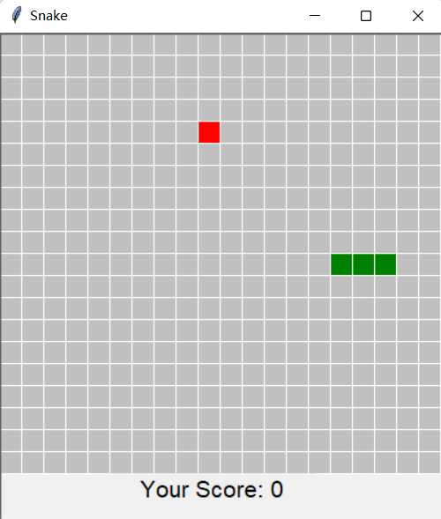
# Up (-1) Down (1) Left (-2) Right (2)
direction = 2
def callback(event) :
global direction ch = event.keysym
if ch == "Up":
if snake_list[0][0] != snake_list[1][0]:
direction = -1
# etc.
CHAT_MAIN_PANEL → snake game
2048 GAME
CHAT_MAIN_PANEL
SNAKE GAME
def draw_the_snake(canvas, snake_list, color="green"):
for i in snake_list :
draw_unit(canvas, i[0], i[1], unit_color=color)
fps = 150
def game_loop(): global fps
global snake_list
win.update()
food(canvas, snake_list)
snake_list = snake_move(snake_list, direction)
flag = snake_death_judge(snake_list)
if flag:
over_lavel = Label(win, text="Game Over",
font=("Arial", 25),
width=15, height=1)
over_lavel.place(x=40, y=height / 2, bg=None)
return fps = max(int(197 / len(snake_list) ** 0.25), 75)
win.after(fps, game_loop)
snake_list = [[11, 10], [10, 10], [9, 10]]
def snake_move(snake_list, dir):
global row, col
global have_food
global food_coord
global score
new_coord = [0, 0] if dir % 2 == 1:
new_coord[0] = snake_list[0][0]
new_coord[1] = snake_list[0][1] + dir
else:
new_coord[0] = snake_list[0][0] + int(dir / 2)
new_coord[1] = snake_list[0][1]
snake_list.insert(0, new_coord)
def food(canvas, snake_list): if have_food:
return food_coord[0] = random.choice(range(col))
food_coord[1] = random.choice(range(row))
while food_coord in snake_list :
food_coord[0] = random.choice(range(col))
food_coord[1] = random.choice(range(row))
draw_unit(canvas, food_coord[0], food_coord[1], unit_color="red")
have_food = 1
# Get food, append to head
if snake_list[0] == food_coord:
draw_unit(canvas, snake_list[0][0], snake_list[0][1],)
have_food = 0
score += 10
str_score.set(“Your Score: “ + str(score))
# Get no food, remove from tail
else:
draw_unit(canvas, snake_list[-1][0], snake_list[-1][1],
unit_color="silver")
draw_unit(canvas, snake_list[0][0], snake_list[0][1],)
snake_list.pop() return snake_list
# Cross the boundary
for coord in snake_list:
if coord[0] not in range(col):
coord[0] %= col
break
elif coord[1] not in range(row):
coord[1] %= row
break
UNIT_SIZE = 20
def draw_unit(canvas, col, row, unit_color="green"):
x1 = col * UNIT_SIZE
y1 = row * UNIT_SIZE
x2 = (col + 1) * UNIT_SIZE
y2 = (row + 1) * UNIT_SIZE
canvas.create_rectangle(x1, y1, x2, y2, fill=unit_color,
outline="white")
button8 = Button(self.main_frame, command=self.game_snake)
button8.place(x=362, y=525)
def game_snake(self):
os.startfile("D:/ICS_final/game_snake.py")
def snake_death_judge(snake_list):
set_list = snake_list[1:]
return int(snake_list[0] in set_list)

Slide 39
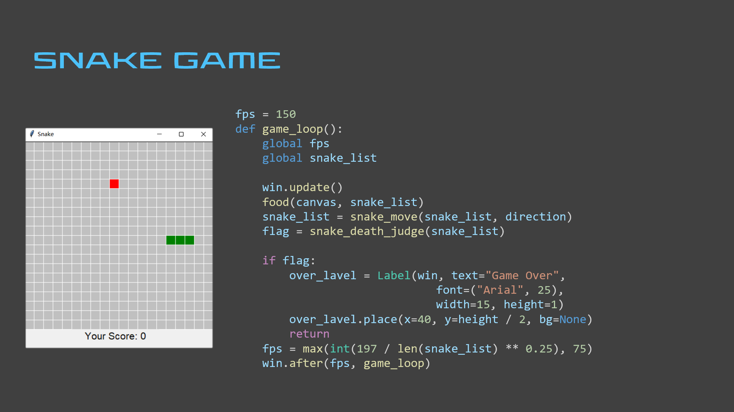


Slide 40
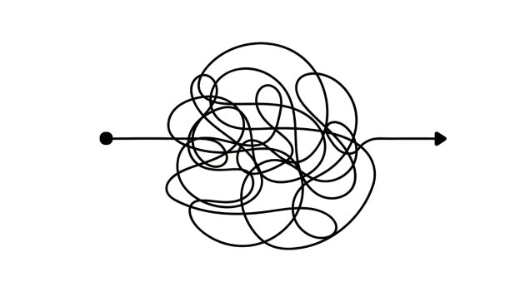


REFLECTION
reference
Bro Code. “Python snake game🐍.” YouTube video, 33:05. Feb 11, 2021. https://youtu.be/bfRwxS5d0SI.
complexity
Special thanks to
Xianbin Gu
Wen Yin
Reducing time and space complexity
Hackers Realm. “1. Python GUI Chat Application | Building GUI using Tkinter.” YouTube video, 17:24. May 24, 2021. https://youtu.be/7BqUSWovVY8.
Kite. “How to Build 2048 in 20 Minutes (Python and Tkinter tutorial).” YouTube video, 19:20. May 16, 2020. https://youtu.be/b4XP2IcI-Bg.
Adding small groups
Modifying user information
Exchanging more types of messages
Invisible mode
More
functions
Presented by
Yao Xiao | yx2436
Romee Zhou | yz7258
Stormzhuo. “Python chat room (Tkinter interface, Threading, Socket chat and chat history, Mysql save data).” Python chat room (Tkinter interface, Threading, Socket chat and chat history, Mysql save data)_努力是为了站在万人中央，成为别人的光-CSDN blog, April 22, 2021. https://blog.csdn.net/weixin_42768634/article/details/116005425.
interface
Fancier interface with
import time
import math
import numpy
import random
import os
import sys
import socket
import pymysql
from PIL import Image
from threading import Thread
from nltk.util import ngrams
from tkinter import *
import tkinter.font as tf
import tkinter.filedialog
from tkinter import messagebox

Slide 41


